Slide 1




So You want to share your research data?
The Penn State Data Commons

Slide 2
My research Group
Developed the PA Flood Risk Assessment Tool
pafloodrisk.psu.edu
Developed and manage Pennsylvania Spatial Data Access
pasda.psu.edu
Manage the Penn State Data Commons research data repository
datacommons.psu.edu
Developing 3D Pennsylvania
Collaborate across PSU
Climate Consortium
CIVIC
Flood Risk Working Group
Sea Grant
Center for Critical Minerals
Collaborate across the state, federal, local, and non profit organizations including NWS/NOAA, DOE, USGS, FEMA, PADEP, PEMA, PennDOT, WeConservePA, and more.
Manage Historic Aerial Photos
pennpilot.psu.edu
Host and manage current imagery, elevation, lidar, state and federal data, underground mine maps (minemaps.psu.edu)

Slide 3

What is the Penn State Data commons?
The Data Commons is an institutional repository for Penn State research data.
Over 300 PSU researchers share data through the Data Commons.
It also hosts core data to support research, teaching, and outreach.

Slide 4
Background
2005 Concept first presented as an environmental data library and repository data created by PSU faculty, researchers, and collaborators. Received a $5K grant from PSU to explore the concept and acquire data.
2023 The Data Commons hosts and provides access to approximately 800tb of data. Data storage is provided by the Institute for Computational and Data Sciences. Institute for Energy and the Environment supports DC staff and EMS has staff member who supports data transfer to DC.

Slide 5
Services
Data discovery & public access
Data storage
Data archiving
Support for development of agency required data management plans
Metadata development and data management seminars
Creation of Digital Object Identifiers (DOIs)
Visualization of compatible data
Core data

Slide 6
approach
Mediated approach—no self service.
Why a mediated approach?
We work directly with researchers throughout the data management life cycle.
Data is often too large to upload via self service mechanisms.
Develop more complete metadata.
Need to compress and organize data for download or create streaming services.

Slide 7
What does the data commons provide access to?
Research data
Core Data: imagery, databases, spreadsheets, geospatial data, satellite imagery, vector data, grids)
Metadata
Documentation of protocols (included in metadata)
Models
Apps & Tools
Reports
Publications (via links, DOIs)

Slide 8
Who shares Data via Data Commons?
Meteorology
Civil Engineering
Chemistry
Aerospace Engineering
Forest Resources
Acoustics
Ecosystem Science
Animal Science
Mechanical and Nuclear Engineering
Mining Engineering
Entomology
Landscape Architecture
Geography
Meteorology
Physics

Slide 9
Who shares Data via Data Commons?
Huck
EESI
IEE
Climate Consortium
SAFES Institute
Noid Lab
OPP
Ice and Climate Research Center

Slide 10
Projects
NewBio
Shalenetwork
Ensemble Mars Atmosphere Reanalysis System
Flood Mitigation in Pennsylvania’s Rural Communities
Piloting a Data and Metadata Hierarchy for Use around United States Cities and Airports
Earth system and climate model output
High-Resolution Rapid Refresh (HRRR) Model
VORTEX
Atmospheric Marcellus shale measurements
National Carbon Program’s Mid Continental Intensive (MCI)
Indianapolis Flux (INFLUX) experiment
WRF-GHG model output from North American domain
Terrestrial Lidar Data

Slide 11

Potential Collaboration opportunities
Human Health/Flood Impacts
Climate
Agricultural Impacts and Mitigation
Social Disparities
Business/Economic Disruptions and Mitigation
Real Estate/Risk/Actuarial Science
Food Security
3D & AI
Emergency & Disaster Response/Preparedness
Infrastructure/Civil Engineering
Flood Pollution Impacts
Data Science & Data Development
Drones
Critical Minerals
Agricultural Sustainability
GIS Related Projects and Apps

Slide 12
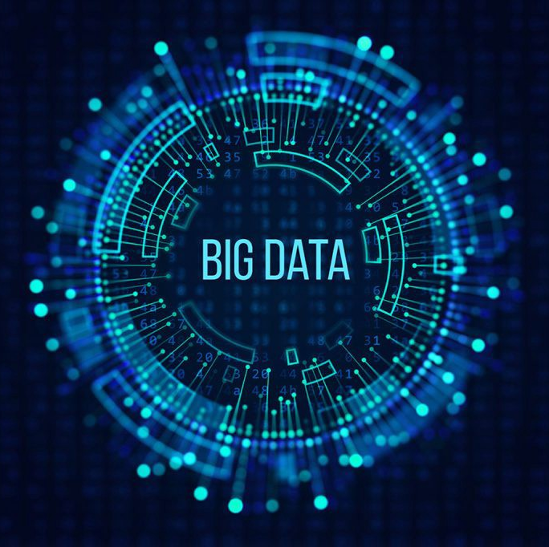
But I have Big data, can you handle it?
Big data is data that is one or all of the following: high volume, high velocity (speed of data in and out), thousands or millions of files.
Data Commons hosts small data sets and big data.
We have expertise in working with large, complex data.
Notes:
Source: 3D Data Management

Slide 13
Impact
The presence of the Data Commons at Penn State positions the university as a leader in providing public access to research data.
It demonstrates Penn State’s ability to support big data projects and programs and enables Penn State to be even more competitive for large multi-institutional data driven projects.
Data Commons aligns to the FAIR principles, and is an approved repository for multiple journals, RE3Data.org, and the Research Data Alliance, and data.gov

Slide 14
Getting Started: New Proposals
In your data management plan, include the Data Commons. We have information you can use to populate your DMP.
Be sure to consider funding for managing and storing your data. Data Commons is hosted by the Institute for Computational and Data Sciences (ICDS). The funding should support ICDS.
Feel free to reach out to us during your project. We can provide advice on Best Management Practices for data management for future publication.

Slide 15
Ready to Share?
Contact us at datacommons@psu.edu
We will work with you to get your data ready to share publicly.
We will create metadata, a DOI, and links to related material.

Slide 16
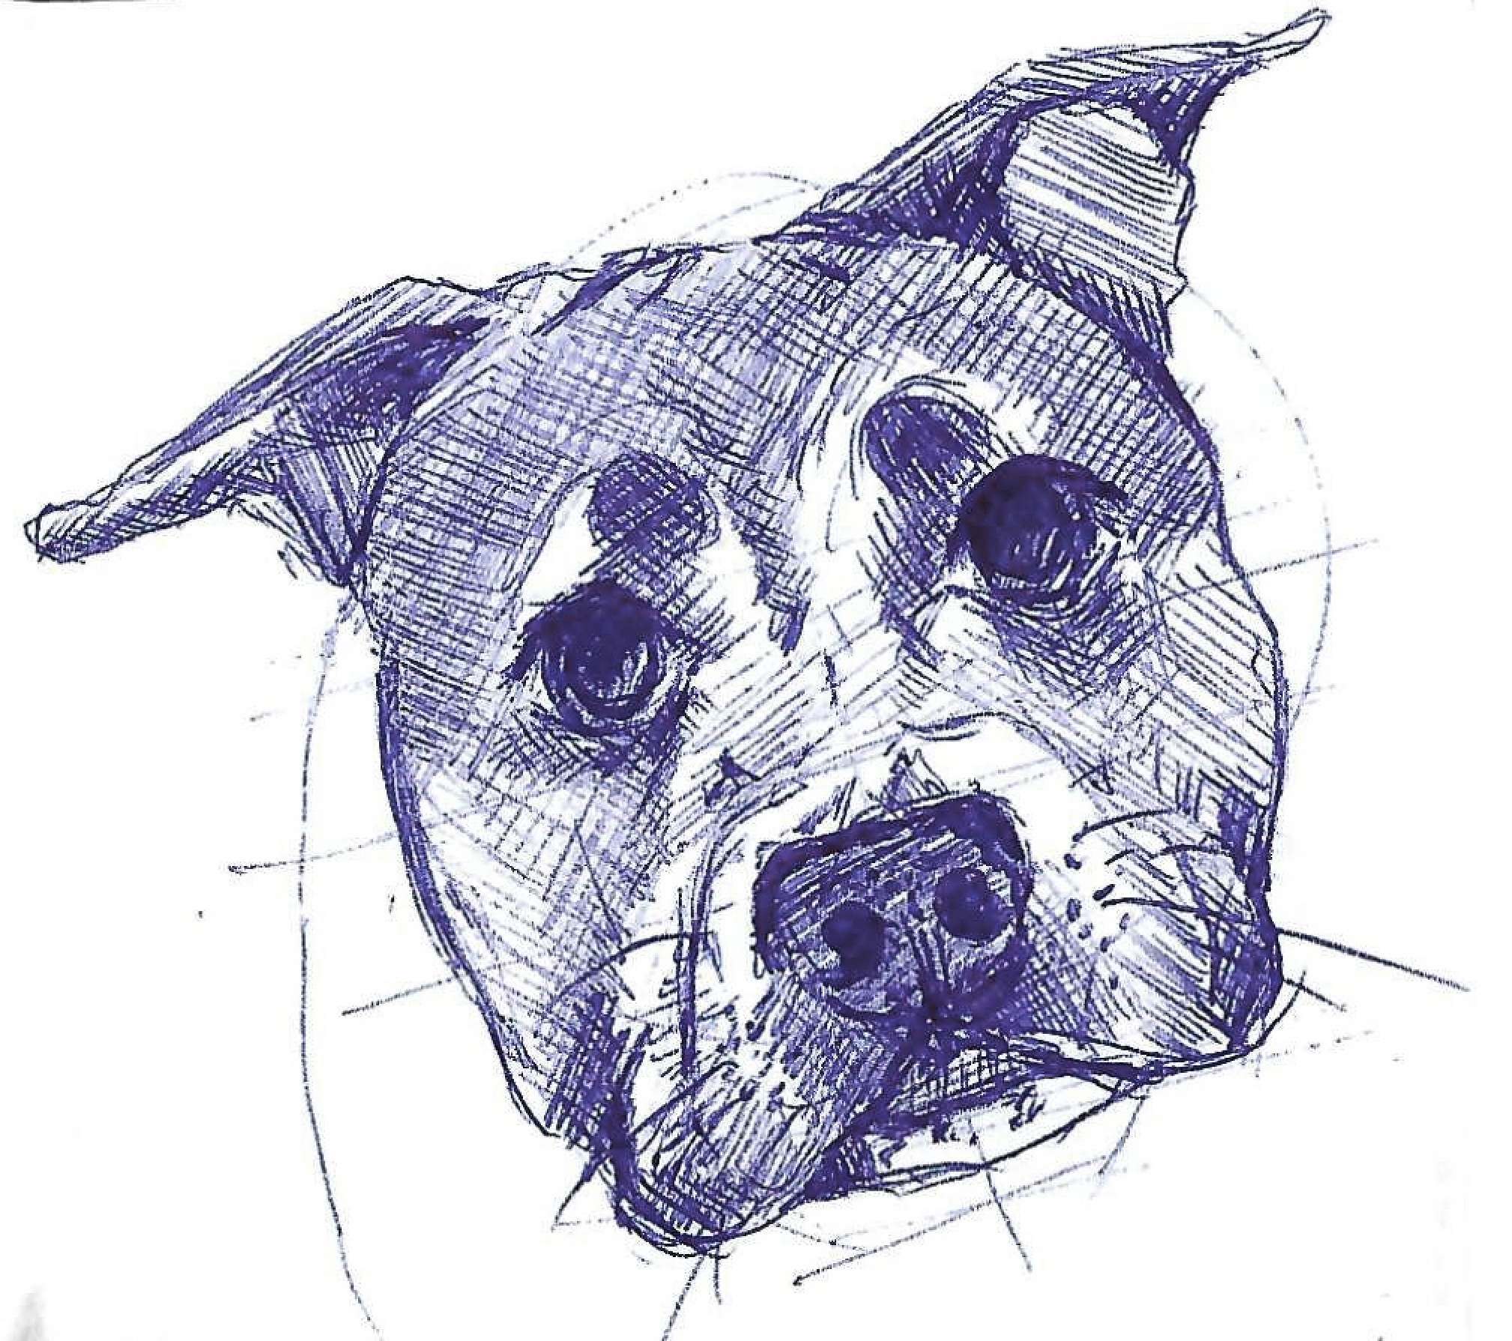
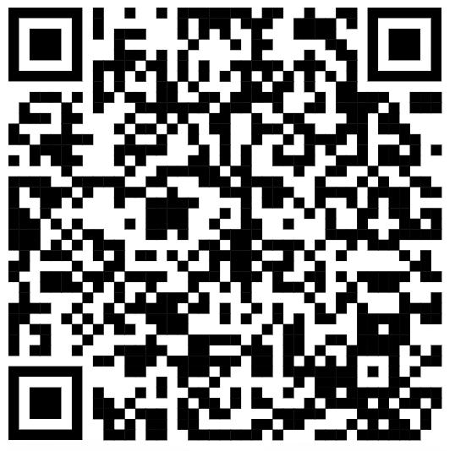
Thank You! Questions?
Email
LinkedIn
URLs
mck4@psu.edu
pafloodrisk.psu.edu
pasda.psu.edu
datacommons.psu.edu
minemaps.psu.edu
pennpilot.psu.edu

